Slide 1
GA Final Project
Predicting Indonesian Interest Rate Movements
By: Adam Jarczyk

Slide 2
Agenda
Motivation
Project Question
Data Collection
Data Exploration
Models for Testing
Data Processing Options
Choosing and Refining the Model
Results
Next steps

Slide 3
Motivation
Benchmark interest rate
Exchange rates
Stock prices
Inflation
Bond prices
Economic growth
Etc.
Central Bank
If we can determine how central bankers are going to adjust interest rates, we can make better predictions about a variety of different economic and financial metrics

Slide 4
Project Question
Can we predict interest rate movements in Indonesia based on the central bank’s statements?
?
Bank Statement
Data Science Model
Prediction

Slide 5
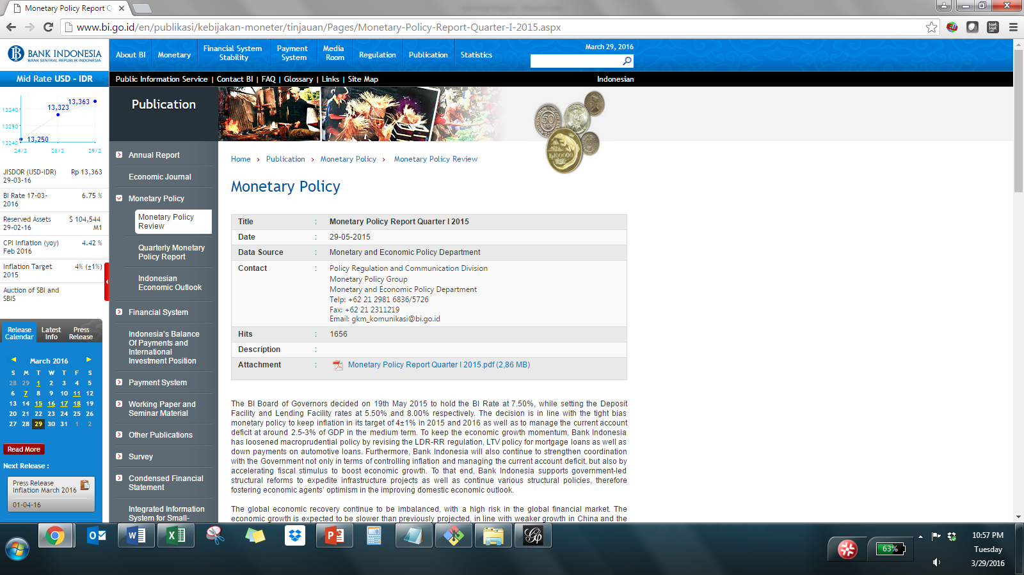
Data Collection
Bank Indonesia Monetary Policy Reports and Reviews
(Feb 2009 – Nov 2015)
Copied Central Bank
Summaries into Text Files

Slide 6
Data Collection
Table of interest rate movements
Summary Date | Number | Decreased | Same | Increased
2/3/2009 | 1 | 1 | 0 | 0
3/20/2009 | 2 | 1 | 0 | 0
4/20/2009 | 3 | 1 | 0 | 0
5/13/2009 | 4 | 1 | 0 | 0
6/9/2009 | 5 | 1 | 0 | 0
7/17/2009 | 6 | 1 | 0 | 0
8/13/2009 | 7 | 0 | 1 | 0
9/10/2009 | 8 | 0 | 1 | 0
10/22/2009 | 9 | 0 | 1 | 0
11/17/2009 | 10 | 0 | 1 | 0
… | … | … | … | …
Built Table Using Information from the Central Bank Website

Slide 7
Data Exploration
Interest rate decisions within sample
Sample size limited;
classes skewed, so it probably makes sense to use only two classes (Same and Move)

Slide 8
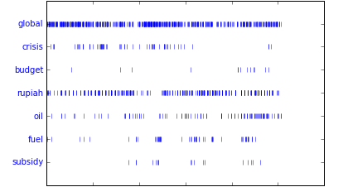
Data Exploration
Lexical Dispersion Plot
Document composition and focus varies over time
2009
2015

Slide 9
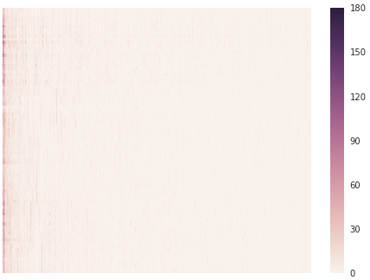
Data Exploration
Heat Map of the 500 Most Prevalent 2-Grams (Pre-processing)
2009
Bank Statements
Looks like this data will need some scrubbing…
2015
0
500
2-Grams

Slide 10
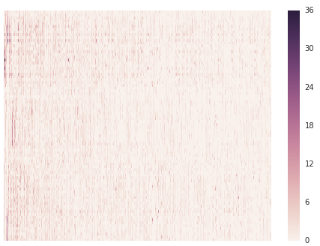
Data Exploration
Heat Map of the 500 Most Prevalent 2-Grams (Post-processing)
2009
Bank Statements
Even after some scrubbing, we see significant variation across statements
2015
0
500
2-Grams

Slide 11
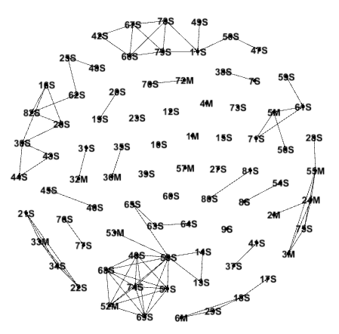

Data Exploration
Clustering
Calculated Jaccard coefficients for all documents relative to one another and arranged in a similarity matrix
Defined edges using the largest Jaccard coefficients (75th to 100th percentile)
Used Gephi to map the clusters
Numbers: the document number
Letters: S = Same, M = Move

Slide 12

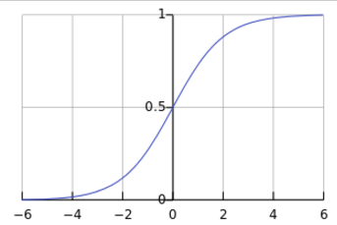
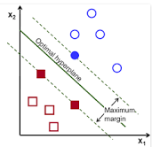
Models for Testing
Bernoulli Naïve Bayes
Multinomial Naïve Bayes
0, 1, 1, 1, 0, 0, 0, 0, 0, 1, 1, 0
4, 1, 0, 1, 3, 10, 4, 0, 2, 1, 1, 0
Logistic Regression
Support Vector Machine

Slide 13
Data Processing Options
Parameters
ngram_range: set the range of n-grams to be considered (i.e., 1-grams, 2-grams, 3-grams, etc.)
stop_words: ignore common words in a given language that generally hold little meaning
max_df: ignore terms that have a document frequency higher than the given threshold
min_df: ignore terms that have a document frequency lower than the given threshold

Slide 14
Choosing and Refining the Model
Process
Define baseline accuracy to evaluate models
Run all models without any parameter changes
Change parameters one at a time; run the models after each change and calculate the training set accuracy, test set accuracy, and area under the curve (AUC) for each
Keep the parameter that exhibits the best performance in these three areas
Restart the process starting at step 3 until changing additional parameters leads to a decline in performance

Slide 15
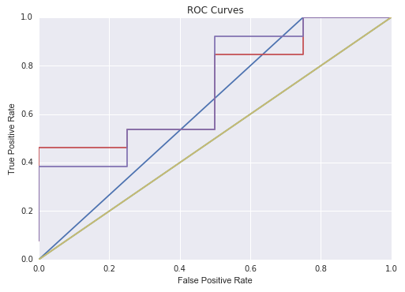
Results
max_df=0.8, ngram_range=(1,2)
 | AUC | Training Set Accuracy | Testing Set Accuracy
Baseline | N/A | N/A | 76.5%
Bernoulli NB | 50.0% | 86.2% | 76.5%
Multinomial NB | 62.5% | 100.0% | 82.4%
Logistic Regression | 71.2% | 100.0% | 82.4%
Support Vector Machine | 71.2% | 100.0% | 82.4%
 | Bernoulli NB
 | Multinomial NB
 | Logistic Regression
 | Support Vector Machine

Slide 16
Next steps
Potential areas for exploration
Expand English data set by reading in PDFs
Bahasa statement analysis
Replicate process for other countries
Automate process for reading new data into model and making predictions

